Slide 1





Macro Checker Fitness Guide
Rachel Bemis

Slide 2
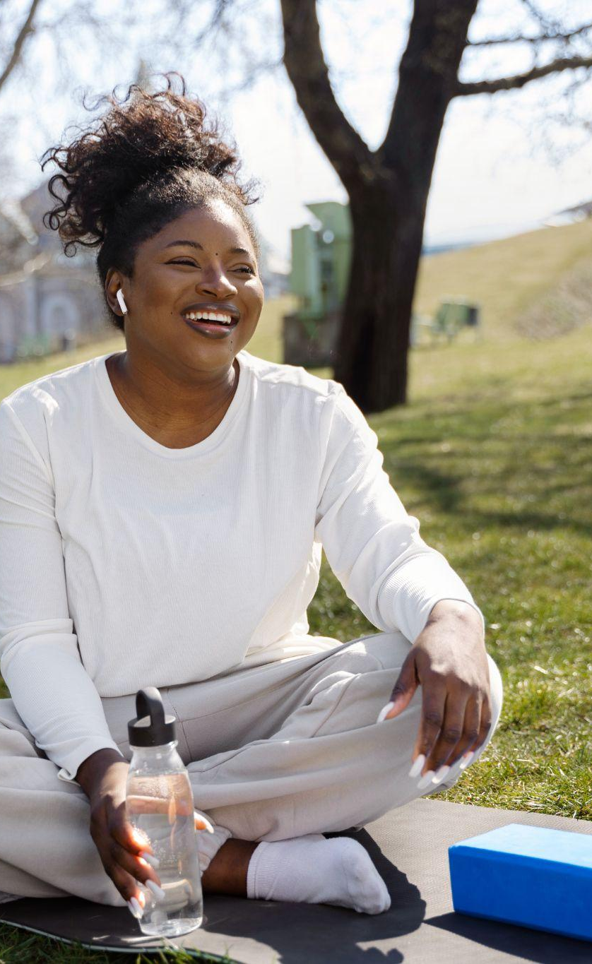
Goal
The goal for this project is to assist people in determining their macros based on their level of activity, age, gender, height, and weight.
The goal is to show a unique value per person with a breakdown of carbs, fats, and proteins while providing an overall calorie deficit.

Slide 3
Motivation
Desire to be Healthy
Use of Code
In today’s world people have a desire to be healthy, but a lot of times they don’t know where to start. This tool will be the beginning stages of helping someone get started with determining their macros.
This is a great example of being able to use code that has been learned throughout the course to improve health.

Slide 4
Logic
TDEE (Total Daily Energy Expenditure) is calculated by
tdee = bmr * activity_factors[activity_level]
BMR is calculated using the following code
Bmr (Male) = 10 * weight + 6.25 * height - 5 * age + 5
Bmr (Female) = 10 * weight + 6.25 * height - 5 * age - 161
Macros are broken down based on TDEE
carbs = (0.5 * tdee) / 4 # Carbs = 50% of TDEE, 4 kcal per gram
protein = (0.25 * tdee) / 4 # Protein = 25% of TDEE, 4 kcal per gram
fats = (0.25 * tdee) / 9 # Fats = 25% of TDEE, 9 kcal per gram

Slide 5
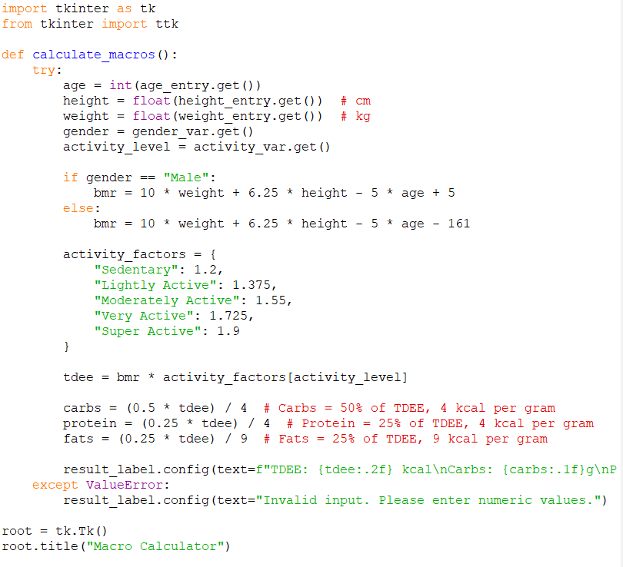
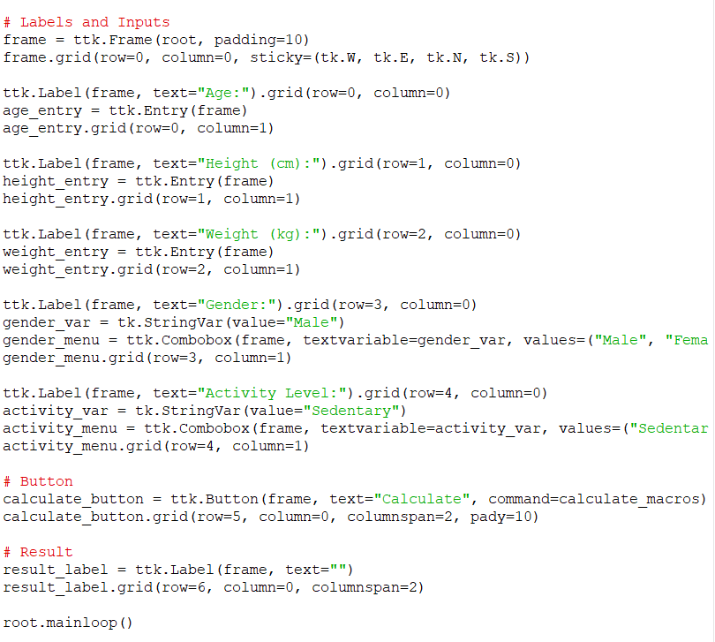
Code

Slide 6
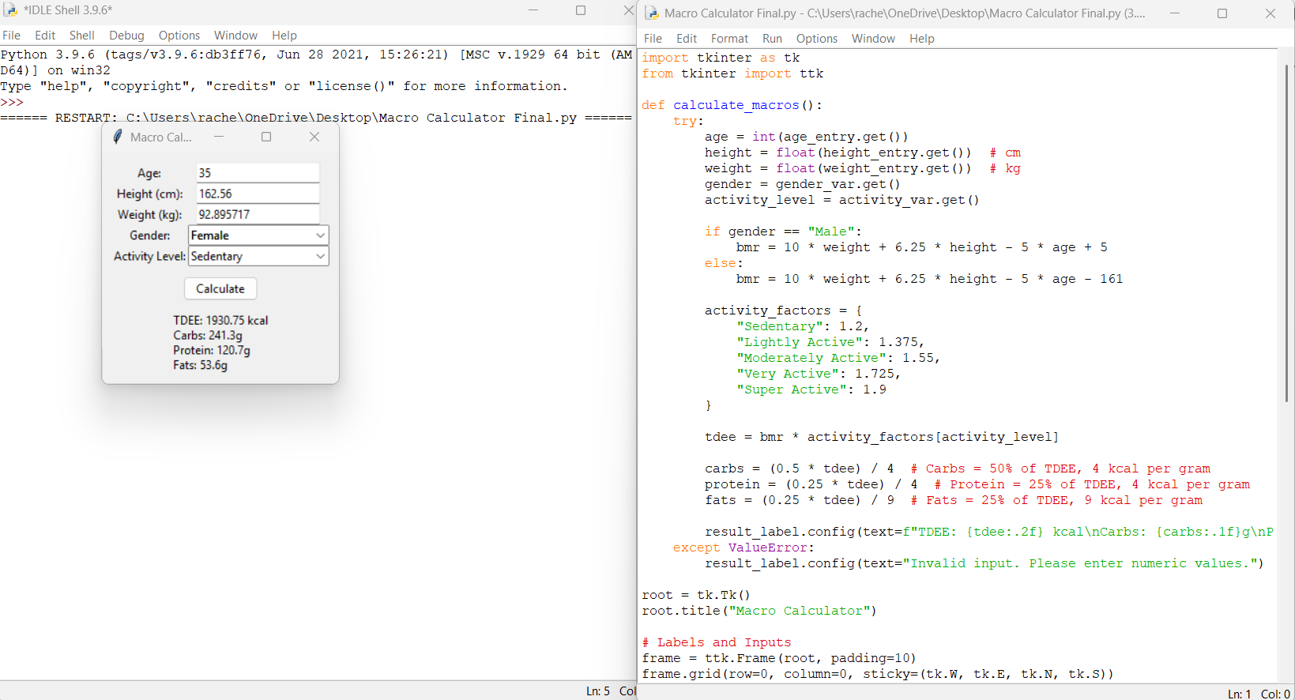
Output

